Slide 1
Functional Reactive Bitcoin Trading
Dimitri DeFigueiredo Ph.D.
BayHac 2017

Slide 2
Part 1 – Trading & Bitcoin

Slide 3
The Market for Microsoft shares
NASDAQ Orderbook
Asks
BUY 10 MSFT $50 each
SELL 10 MSFT $60 each
BUY 8 MSFT $45 each
SELL 5 MSFT $47 each
BUY 5 MSFT $50 each
Bids

Slide 4
The Market for Microsoft shares
NASDAQ Orderbook
Sell
ASK 3 $66
ASK 10 $60
ASK 2 $59
BID 5 $50
BID 8 $45
Buy

Slide 5
The Market for Microsoft shares
NASDAQ Orderbook
Sell
ASK 3 $66
ASK 2 $59
ASK 10 $60
BID 5 $50
BID 8 $45
Buy

Slide 6
The Market for Microsoft shares
NASDAQ Orderbook
ASK 3 $66
Sell
ASK 6 $60
ASK 10 $60
BID 6 $61
ASK 2 $59
BID 5 $50
BID 8 $45
Buy

Slide 7
The Market for Microsoft shares
NASDAQ Orderbook
Sell
ASK 3 $66
ASK 2 market
ASK 6 $60
BID 3 $50
BID 5 $50
BID 8 $45
Buy

Slide 8
The Market for Microsoft shares
NASDAQ Orderbook
Sell
ASK 3 $66
BID mrkt $200
ASK 3 $60
ASK 6 $60
BID 3 $50
BID 8 $45
Buy

Slide 9
The Market for Microsoft shares
NASDAQ Orderbook
Sell
ASK x $xx
ASK 3 $66
BID 20 $35
ASK x $xx
BID 20 $35
BID 20 $35
ASK 5 $55
ASK 3 $60
BID 20 $35
ASK 6 $60
BID 3 $50
BID 8 $45
Buy

Slide 10
The Market for Microsoft shares
Bid = Buy Ask = Sell
Limit order vs. Market order
FIFO processing
Always execute at the price on the orderbook

Slide 11
Bitcoin Market Basics
Bitcoins can be divided into 100 000 000 (i.e. 10⁸) satoshi
Exchanges are website

Slide 12
GDAX/Bitstamp Demo
https://www.gdax.com/trade/BTC-USD
https://www.bitstamp.net/market/tradeview/

Slide 13




Bitcoin Exchanges…

Slide 14
How do we trade?
On exchange website
Exchanges provide REST / FIX / Websocket APIs

Slide 15
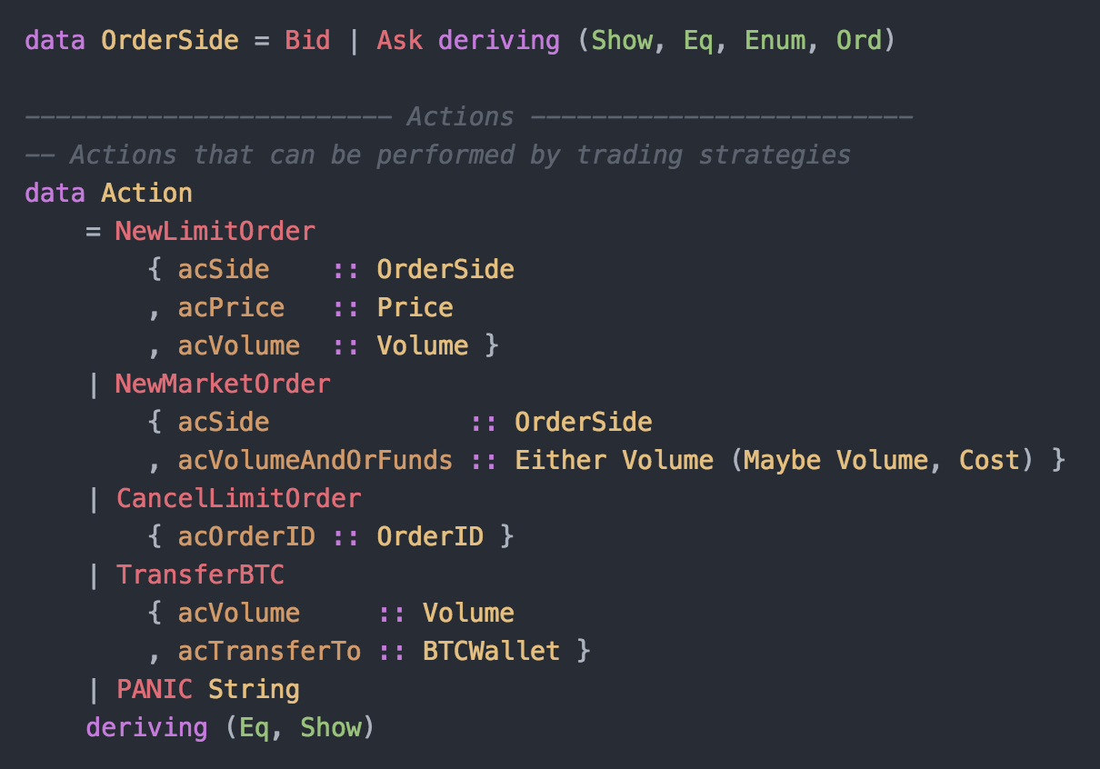
How do we trade?
data OrderSide = Bid | Ask deriving (Show, Eq, Enum, Ord)
data Action
= NewLimitOrder
{ acSide :: OrderSide
, acPrice :: Price
, acVolume :: Volume }
| NewMarketOrder
{ acSide :: OrderSide
, acVolumeAndOrFunds :: Either Volume (Maybe Volume, Cost) }
| CancelLimitOrder
{ acOrderID :: OrderID }
| TransferBTC
{ acVolume :: Volume
, acTransferTo :: BTCWallet }
| PANIC String
deriving (Eq, Show)

Slide 16
Part 2 – Bitcoin Trading APIs

Slide 17
Exchange API Problems…
Synchronization
Synchronization
Synchronization

Slide 18
Is my order in the orderbook?
1. Place an order to buy
POST https://www.bitstamp.net/api/v2/buy/btcusd/ ...
(Limit Bid price = $1077.77 volume = 3 BTC)
Response (JSON): success
id 384959582884
datetime 02 Apr 2017 23:40:12
type 0 (buy)
price 1077.77
amount 3

Slide 19
Is my order in the orderbook?
2. Get the latest orderbook
GET https://www.bitstamp.net/api/v2/order_book/btcusd/
{"timestamp": "1491176412",
"asks": [
["1078.30", "1.60987072"],
["1078.51", "0.37900000"],
["1078.84", "7.50000000"], ... ]
"bids": [
["1078.25", "2.69672460"],
["1077.77", "7.50000000"],
["1077.01", "0.20000000"], ... ]}
Our order:
Buy 3 BTC for $1077.77 each

Slide 20
Is my order in the orderbook? Attempt 2
1. Place an order to buy
POST https://api.gdax.com/orders ...
(Limit Bid price = $1111.21 volume = 0.01 BTC)
Response (JSON): success
id b45b2b0d-a7f8-47d6-942d-ca439b41abb7
datetime 02 Apr 2017 23:40:12
type 0 (buy)
price 1111.21
amount 0.01

Slide 21
Is my order in the orderbook? Attempt 2
2. Get the latest orderbook
GET https://api.gdax.com/products/BTC-USD/book?level=3
{"sequence":2624663283,
"bids":[
["1111.21","0.6077","fb9f7505-770d-463e-93d9-6270e9b7d496"],
["1111.21","0.01","b45b2b0d-a7f8-47d6-942d-ca439b41abb7"],
["1111.20","0.24","1a27b48e-b10d-42d7-bd47-681212f81b15"],
...
“asks":[ ... ] }
Our Order ID

Slide 22
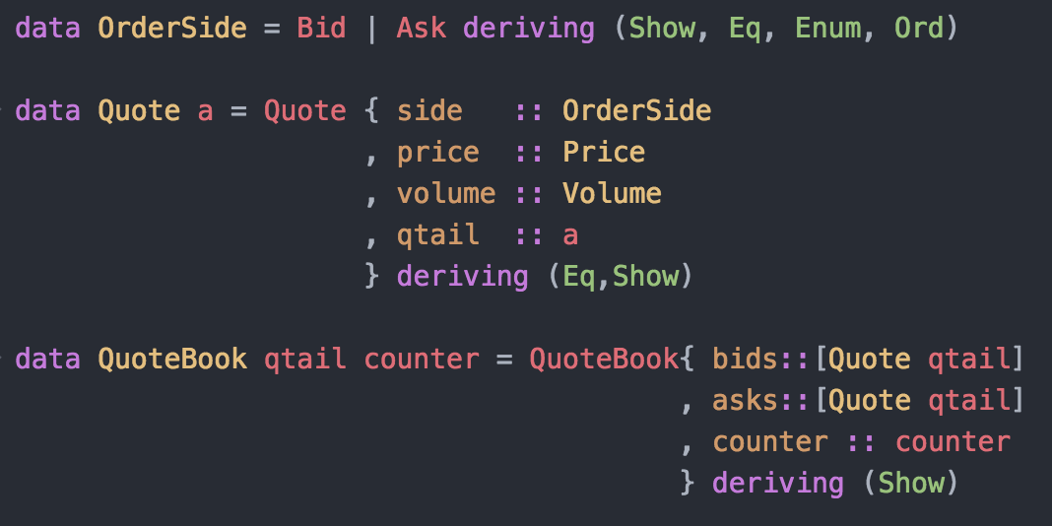
The “orderbook” type
data OrderSide = Bid | Ask deriving (Show, Eq, Enum, Ord)
data Quote a = Quote { side :: OrderSide
, price :: Price
, volume :: Volume
, qtail :: a
} deriving (Eq,Show)
data QuoteBook qtail counter = QuoteBook{ bids::[Quote qtail]
, asks::[Quote qtail]
, counter :: counter
} deriving (Show)

Slide 23
Is my order in the orderbook? Attempt 3
GDAX Provides Websocket feed
GDAX shows opaque Client Order ID in websocket feed

Slide 24
Is my order in the orderbook? Attempt 3
1. Monitor the websocket feed
a. GET initial book
b. apply updates from wss://ws-feed.gdax.com

Slide 25
Is my order in the orderbook? Attempt 3
2. Place an order to buy
POST https://api.gdax.com/orders ...
(Limit Bid price = $1111.21 volume = 0.01 BTC clientOID = 4445555666644)
Monitor websocket feed
If you see 4445555666644 : Ok! Order placed
If you don’t…
timeout => order NOT placed

Slide 26
API Synchronization problems
Examples:
Is my order in the latest orderbook?
Did my order already execute?
How much money/BTC do I have now?

Slide 27
On hold vs. available
Initial amounts: $10K and 10 Bitcoins
1.
Money on hold vs. available
$3000 on hold and $7000 available
2.
Bitcoins on hold vs. available
4 BTC on hold and 6 BTC available
Buy 3 BTC for $1000 each
Sell 4 BTC for $2000 each

Slide 28
Trading is stateful!
What is my dollar balance?
What is the current order book?
What orders have I placed?
Did I make money on my last trade?
Is the price increasing?

Slide 29
Part 3 – Reactive Banana

Slide 30
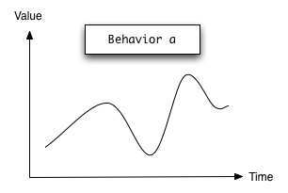
Mental model: FRP = time varying
data Point = Point {x::Int, y::Int}
Continuous → Behavior
mousePosition :: Behavior Point
images from https://hackage.haskell.org/package/reactive-banana-1.1.0.1/docs/Reactive-Banana-Combinators.html

Slide 31
Behaviors can model state
data Point = Point {x::Int, y::Int}
Continuous → Behavior
mousePosition :: Behavior Point
A Behavior is always a well-defined value
images from https://hackage.haskell.org/package/reactive-banana-1.1.0.1/docs/Reactive-Banana-Combinators.html

Slide 32
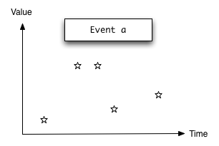
Mental model: FRP = time varying
data Point = Point {x::Int, y::Int}
Continuous → Behavior
mousePosition :: Behavior Point
Discrete → Event stream
mouseClick :: Event Point
images from https://hackage.haskell.org/package/reactive-banana-1.1.0.1/docs/Reactive-Banana-Combinators.html

Slide 33
Reactive Banana
Excellent library by Heinrich Apfelmus!
Event = Event stream
Type hierarchy
:: a :: Event a :: Moment (Event a)
↑ ↑ ↑
does not vary a exists at discrete exists at discrete instants
in time instants has memory

Slide 34
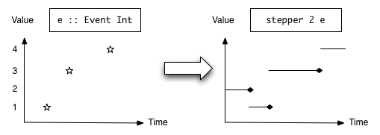
Reactive Banana Combinator examples
filterE :: (a -> Bool) -> Event a -> Event a
apply :: Behavior (a -> b) -> Event a -> Event b
stepper :: MonadMoment m => a -> Event a -> m (Behavior a)
images from https://hackage.haskell.org/package/reactive-banana-1.1.0.1/docs/Reactive-Banana-Combinators.html

Slide 35
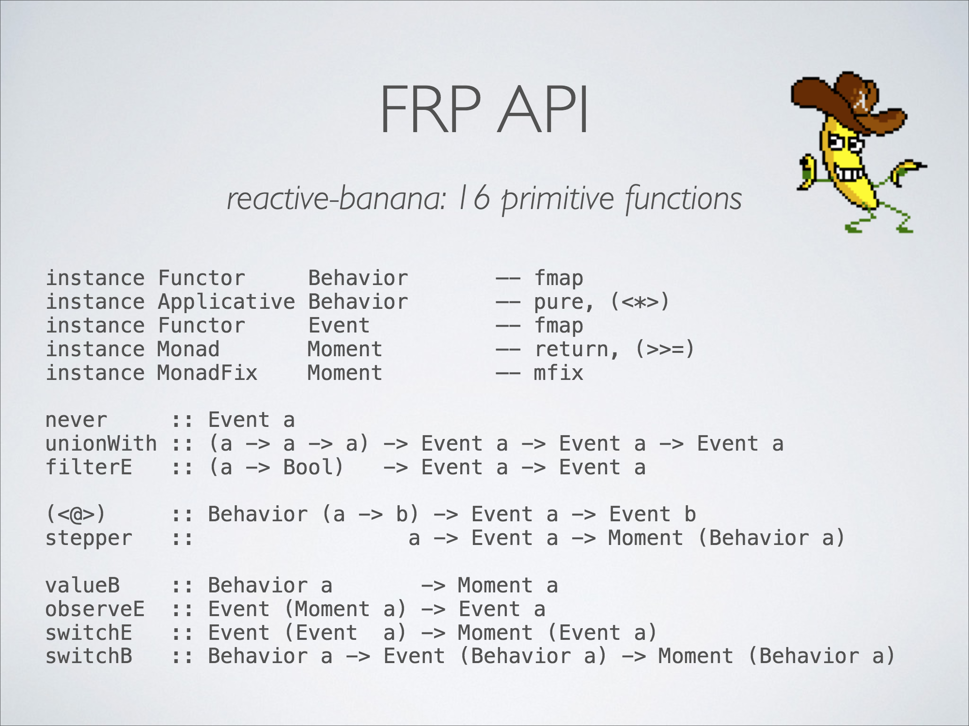
image from https://github.com/HeinrichApfelmus/frp-guides/blob/master/apfelmus/frp-slides.pdf

Slide 36
How do we trade?
data OrderSide = Bid | Ask deriving (Show, Eq, Enum, Ord)
data Action
= NewLimitOrder
{ acSide :: OrderSide
, acPrice :: Price
, acVolume :: Volume }
| NewMarketOrder
{ acSide :: OrderSide
, acVolumeAndOrFunds :: Either Volume (Maybe Volume, Cost) }
| CancelLimitOrder
{ acOrderID :: OrderID }
| TransferBTC
{ acVolume :: Volume
, acTransferTo :: BTCWallet }
| PANIC String
deriving (Eq, Show)

Slide 37
What is a trading strategy?
Input:
Event NewOrderBook
Event OrderPlacement
Event OrderCancellation
Event OrderFill
Output:
Event [Action]

Slide 38
What is a trading strategy?
Input:
Event NewOrderBook
Event OrderPlacement
Event OrderCancellation
Event OrderFill
Output:
Moment (Event [Action])

Slide 39
What is a trading strategy?
Input:
Event NewOrderBook
Event OrderPlacement
Event OrderCancellation
Event OrderFill
Output:
type TradingStrategy = Moment (Event [Action])

Slide 40
Example memoryless strategy
-- filterE :: (a -> Bool) -> Event a -> Event a
-- Immediately cancel any limit order placed
cancelLimitOrders :: Event OrderPlacement -> Event [Action]
cancelLimitOrders placed =
(toList . CancelLimitOrder . getOrderID) <$> filterE isLimitOrder placed

Slide 41
A helper function
-- whenE :: Behavior Bool -> Event a -> Event a
-- stepper :: MonadMoment m => a -> Event a -> m (Behavior a)
-- Outputs only the first ocurrence of the event. Similar to `head`.
first :: MonadMoment m => Event a -> m (Event a)
first event = do
notDoneYet <- stepper True (const False <$> event)
return $ whenE notDoneYet event

Slide 42
Example strategy with memory
-- filterE :: (a -> Bool) -> Event a -> Event a
-- first :: MonadMoment m => Event a -> m (Event a)
-- Immediately cancels *FIRST* limit order placed
cancelFirstLimitOrder :: Event OrderPlacement -> MomentIO (Event [Action])
cancelFirstLimitOrder placed = do
firstOrder <- first (filterE isLimitOrder placed)
return ( (toList . CancelLimitOrder . getOrderID) <$> firstOrder)

Slide 43
Trading “Combinator Library”?
Definitely the goal, but still to do
Reactive Banana is good starting point

Slide 44
Part 4 – The Trading Agent

Slide 45
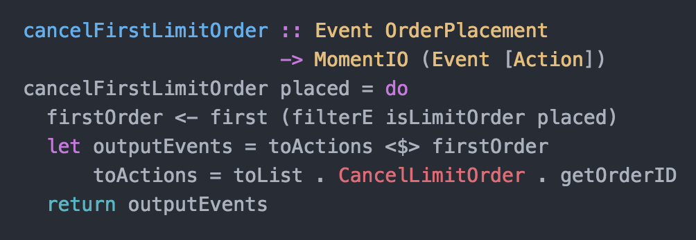
Connecting to the Real-world
How do we run a strategy?
How do we trigger trading events?
How do we place/cancel trades?

Slide 46
Connecting to the Real-world
How do we run a strategy?

Slide 47
Connecting to the Real-world
main = do
network <- compile $ do
cancelFirstLimitOrder placed
return ()
activate network
getLine -- wait for <ENTER> to be pressed
return ()

Slide 48
Connecting to the Real-world
main = do
(placementHandlers, triggerPlacementEvent) <- newHandlerSet
network <- compile $ do
placed <- fromHandlerSet placementHandlers
cancelFirstLimitOrder placed
return ()
activate network
triggerPlacementEvent somePlacement –- callback fires event inside MomentIO
return ()

Slide 49
Connecting to the Real-world
main = do
(placementHandlers, triggerPlacementEvent) <- newHandlerSet
network <- compile $ do
placed <- fromHandlerSet placementHandlers
cancelFirstLimitOrder placed
return ()
activate network
triggerPlacementEvent somePlacement –- callback fires event inside MomentIO
return ()

Slide 50
Connecting to the Real-world
main = do
(placementHandlers, triggerPlacementEvent) <- newHandlerSet
network <- compile $ do
placed <- fromHandlerSet placementHandlers
cancelFirstLimitOrder placed
return ()
activate network
triggerPlacementEvent somePlacement –- callback fires event inside MomentIO
return ()

Slide 51
Connecting to the Real-world
main = do
(placementHandlers, triggerPlacementEvent) <- newHandlerSet
network <- compile $ do
placed <- fromHandlerSet placementHandlers
actions <- cancelFirstLimitOrder placed
reactimate (print <$> actions) -- reactimate :: Event (IO ()) -> MomentIO ()
activate network
triggerPlacementEvent somePlacement –- callback fires event inside MomentIO
return ()

Slide 52
Connecting to the Real-world
main = do
(placementHandlers, triggerPlacementEvent) <- newHandlerSet
network <- compile $ do
placed <- fromHandlerSet placementHandlers
actions <- cancelFirstLimitOrder placed
reactimate (print <$> actions)
activate network
triggerPlacementEvent somePlacement
return ()

Slide 53
Connecting to the Real-world
main = do
(placementHandlers, triggerPlacementEvent) <- newHandlerSet
network <- compile $ do
placed <- fromHandlerSet placementHandlers
actions <- cancelFirstLimitOrder placed
reactimate (print <$> actions)
reactimate (print <$> actions)
activate network
triggerPlacementEvent somePlacement

Slide 54
Connecting to the Real-world
main = do
(placementHandlers, triggerPlacementEvent) <- newHandlerSet
network <- compile $ do
placed <- fromHandlerSet placementHandlers
actions <- cancelFirstLimitOrder placed
reactimate (print <$> actions)
reactimate (print <$> actions)
activate network
triggerPlacementEvent somePlacement

Slide 55
Connecting to the Real-world
main = do
(placementHandlers, triggerPlacementEvent) <- newHandlerSet
network <- compile $ do
placed <- fromHandlerSet placementHandlers
actions <- cancelFirstLimitOrder placed
reactimate (print <$> actions)
reactimate (print <$> actions)
activate network
triggerPlacementEvent somePlacement

Slide 56
Connecting to the Real-world
main = do
(placementHandlers, triggerPlacementEvent) <- newHandlerSet
network <- compile $ do
placed <- fromHandlerSet placementHandlers
actions <- cancelFirstLimitOrder placed
reactimate (print <$> actions)
reactimate (print <$> actions)
activate network
triggerPlacementEvent somePlacement

Slide 57
Connecting to the Real-world
main = do
(placementHandlers, triggerPlacementEvent) <- newHandlerSet
network <- compile $ do
placed <- fromHandlerSet placementHandlers
actions <- cancelFirstLimitOrder placed
reactimate (print <$> actions)
reactimate (print <$> actions)
activate network
triggerPlacementEvent somePlacement
EventNetwork

Slide 58

EventNetwork characteristics
EventNetwork
Huge synchronous callback
Multiple entry points
Multiple exit points (one per call to `reactimate`)
Thread safe!

Slide 59
Feeding the Beast
GDAX websocket
thread
Get data
EventNetwork
…

Slide 60
Feeding the Beast
GDAX websocket
thread
Get data
EventNetwork
IO ()
…

Slide 61
Feeding the Beast
GDAX websocket
thread
Get data
EventNetwork
FIFO
…

Slide 62
Trading Execution
GDAX websocket
thread
GDAX Execution
thread
Get data
EventNetwork
FIFO
Read input
…
IO ()

Slide 63
Execution thread triggers event
GDAX websocket
thread
GDAX Execution
thread
Get data
EventNetwork
FIFO
Read input
…
IO ()

Slide 64
Trade Execution
No guarantee of timely execution – best effort
Multiple threads – market data / execution
unbounded FIFO queue

Slide 65
Trading Agent Model
GDAX websocket
thread
GDAX Execution
thread
EventNetwork
FIFO

Slide 66

Trading Agent Model
GDAX websocket
thread
GDAX Execution
thread
EventNetwork
FIFO
FIFO

Slide 67

Trading Agent Model
GDAX websocket
thread
GDAX Execution
thread
EventNetwork
FIFO
FIFO
FIFO
.
.
.
.
.
.
.
.
.

Slide 68
Conclusion
Key points:
Trading is stateful and synchronous
FRP networks are a good model for trading strategies
Behaviors can model state
Reactive-banana is excellent option for multi-threading

Slide 69
Future work
Trading “combinator library”
Left out
Back testing
Estimation of data feed/execution delays

Slide 70
Thank you!
Code available at https://github.com/dimitri-xyz
Questions?
Suggestions?
defigueiredo@ucdavis.edu

